Slide 1
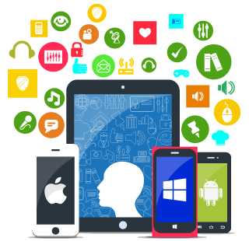
Mobile App Development

Slide 2
Nowadays there is an app for everything or at least that’s what we are trying to do. When mobiles succeeded the regular home phones their only use was to make a call. Later an introduction to mobile apps came with the mobile messaging which lead to having a clock, a calendar, your agenda and all these standard things to the reach of your hand. All of the above are mobile apps that lead to more complex apps, such as connecting a wrist band to your mobile and monitoring your temperature, heart beat etc. An app like that can help a doctor treat and monitor a patient without having the patient staying in a hospital. That’s a long way from just making phone calls, and that’s what mobile app development is used for.

Slide 3
What is mobile app development?
Mobile app development is the process of creating an app by:
An idea for an app
Decide how it is going to work
Design its interface for optimal use
Create the app and test it a lot
Submit it to the app store

Slide 4
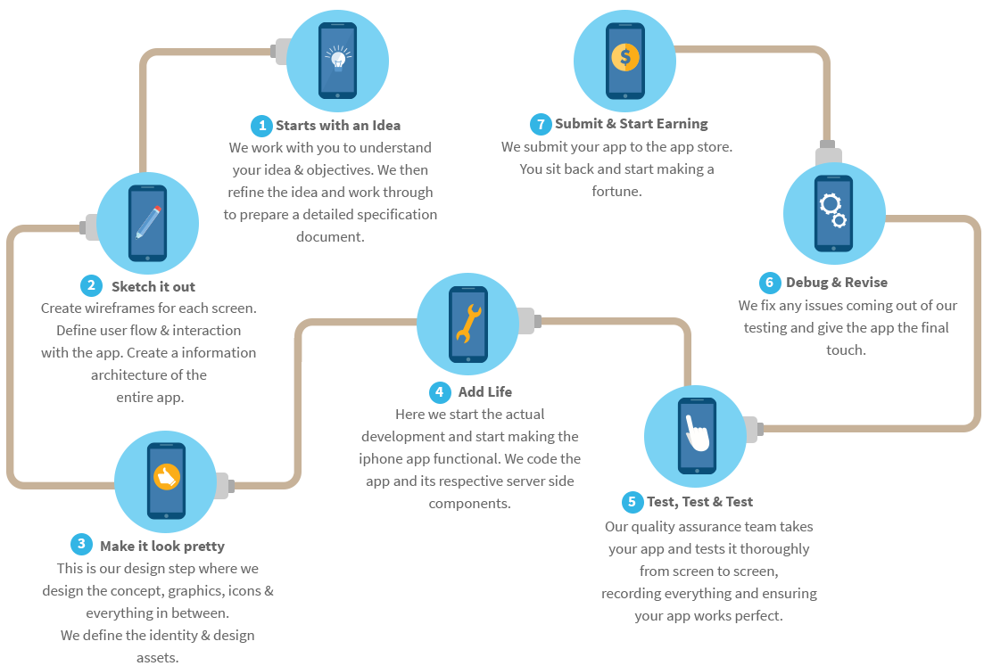

Slide 5
App Design
A big part of an app development is the design of the user interface (UI). That is because there are all kind of users and the app has to be friendly and is to use for anyone of them. It should be simple yet efficient. There is also a variety in screen sizes which cannot be ignored.

Slide 6
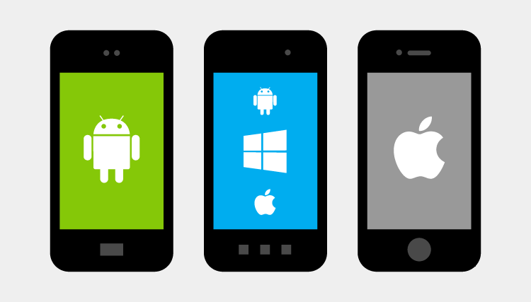
Android, Windows and IOS

Slide 7
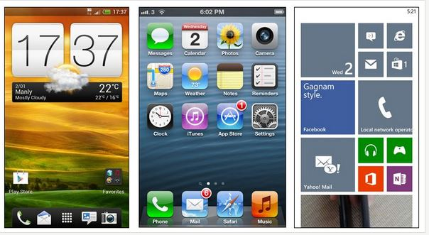
Android, Windows and IOS are the major operating systems for mobiles and its one has different capabilities, weaknesses and strengths. An app has to be developed for its one separately in order to work properly because as we can see even their homepages are different.

Slide 8
Android
Android is the world’s most popular mobile operating system platform.
Pros
Available on a large range of devices
Flexibility
Google services
Widgets
Cons
Android is not about simplicity
Android does not have the best reliability

Slide 9
IOS
Pros
Simplicity is Apple’s strength
Offers consistency across apps and platforms
It’s hard to fault Apple’s reliability
A lot of accessories available
Cons
Device range is limited
Apple devices have apps but no tiles or widgets
Products are not that personalisable
Price. iPhones are expensive

Slide 10
Windows Phone
Pros
Simplicity
Stability
Personalisable
Innovative software features
Cons
Apps. There is a huge lack of apps for Windows Phone users.

Slide 11
Mobile App Uses
As we see in our everyday experience with mobile apps there is a huge variety in what they are used for. This variety starts from updating your social media to helping you navigate through a new town. When combined with the right kind of accessories the number of uses expands even more. As we said at the beginning a doctor can monitor his patient remotely with a wrist band, or you can monitor your exercise activity with a similar device. You can even fly a drone with your mobile phone, know where your dog is with a gps collar, get alerts from your home alarm, control your kitchen and the list goes on.

